Slide 1

VS Code Features You Didn’t Know Existed
Sanjula Ganepola
Software Developer – IBM i App Dev & AI Toolchain
Sanjula.Ganepola@ibm.com
2025 February

Slide 2
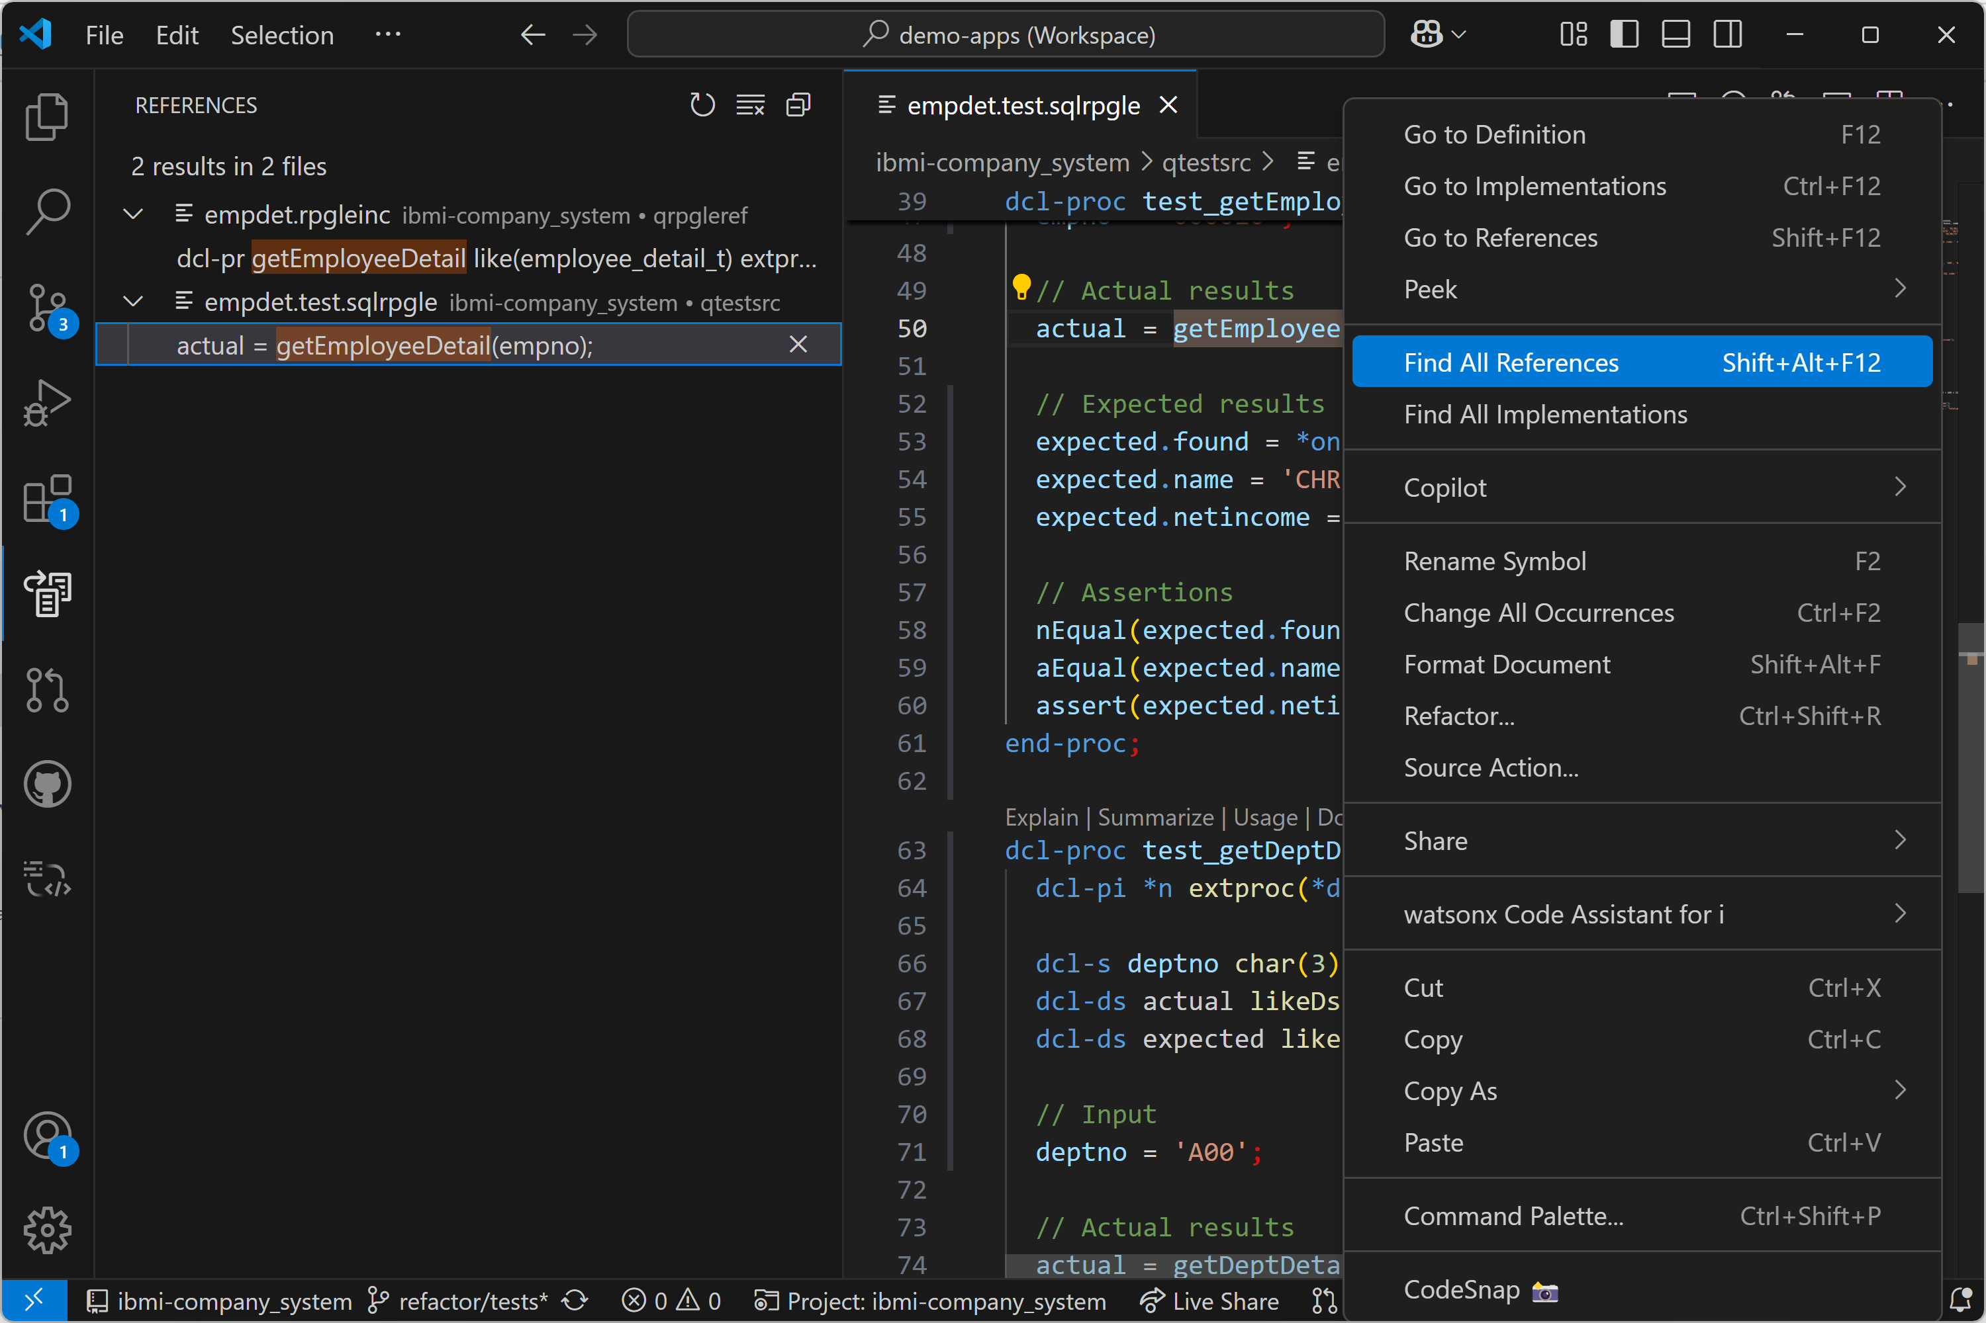
Code Navigation – Go to … and Find All …
Right click on a symbol and use any of the “Go to …” or “Find All …” actions

Slide 3
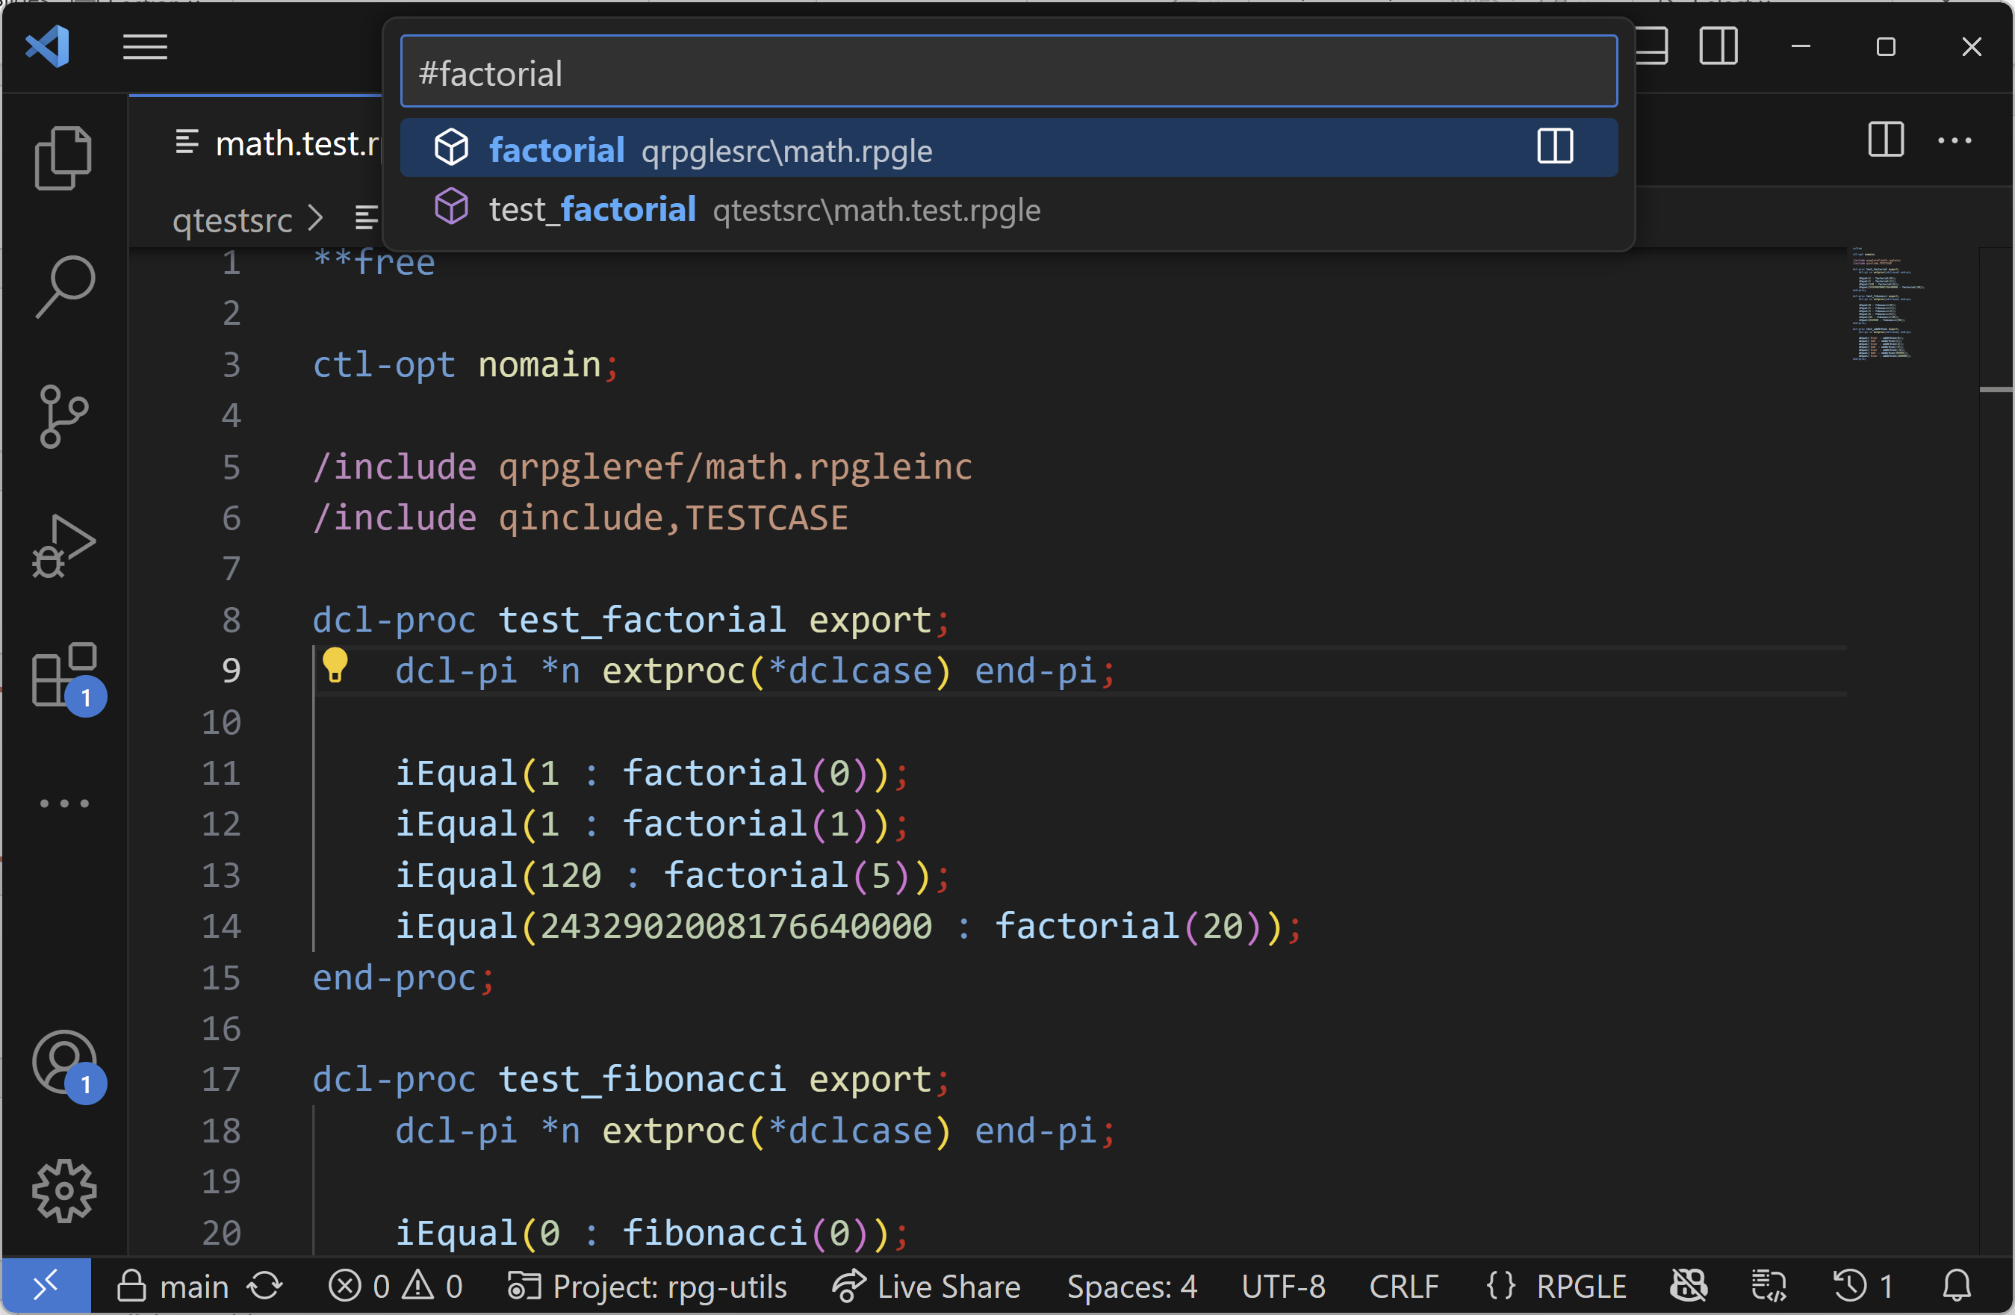
Code Navigation – Go To Symbol in Editor (or Workspace)
Use the command “Go To Symbol in Editor”, “Go To Symbol in Editor by Category” or “Go To Symbol in Workspace”

Slide 4
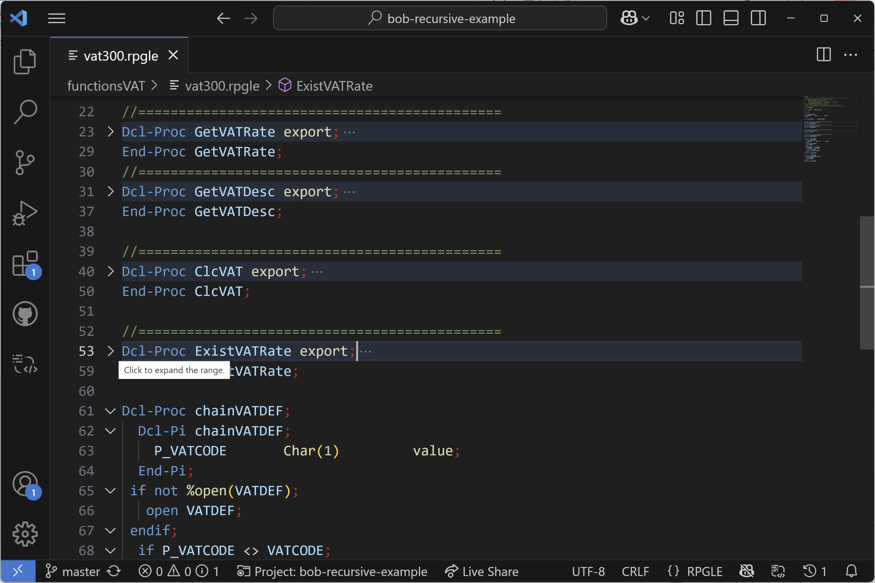
Code Navigation – Code Folding
Works on procedures, prototypes, data structures, etc.

Slide 5
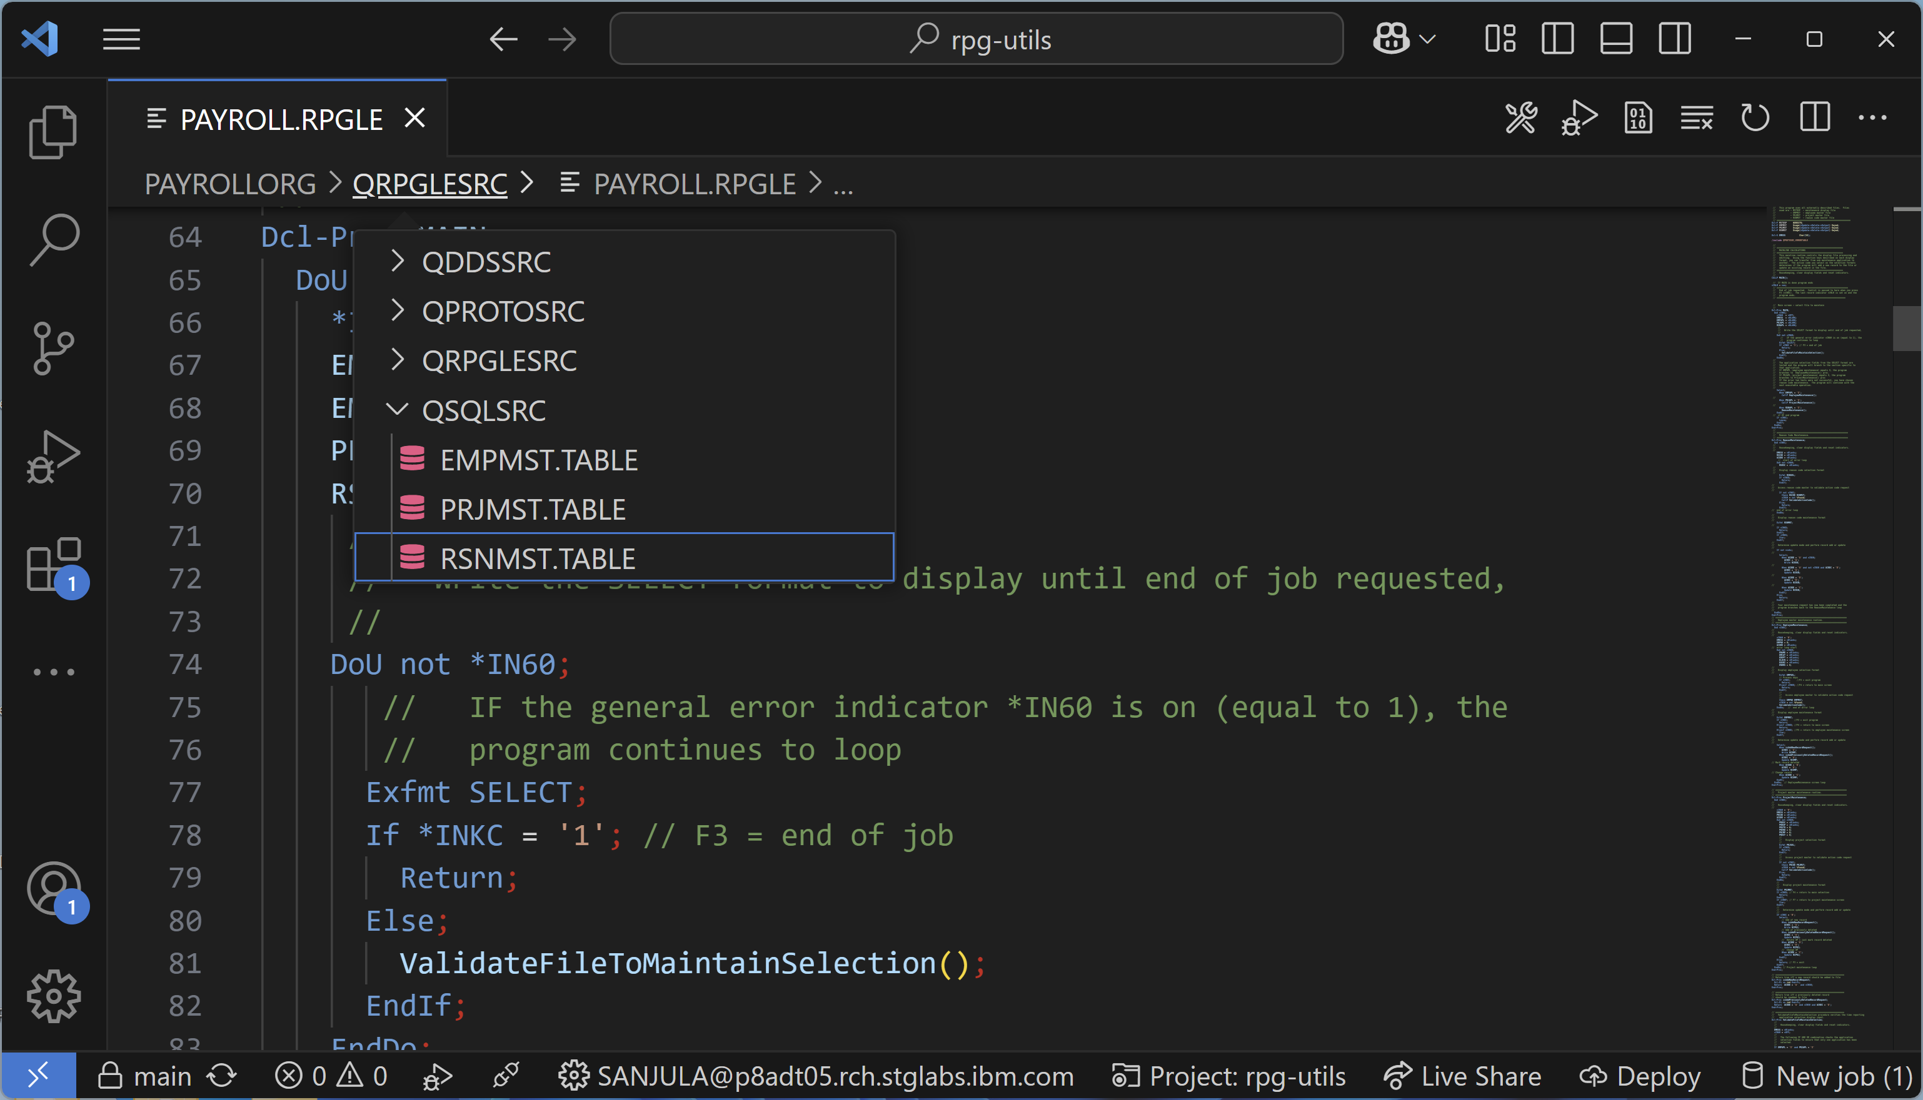
Code Navigation – Breadcrumbs
Works in local, QSYS, and IFS file systems!

Slide 6
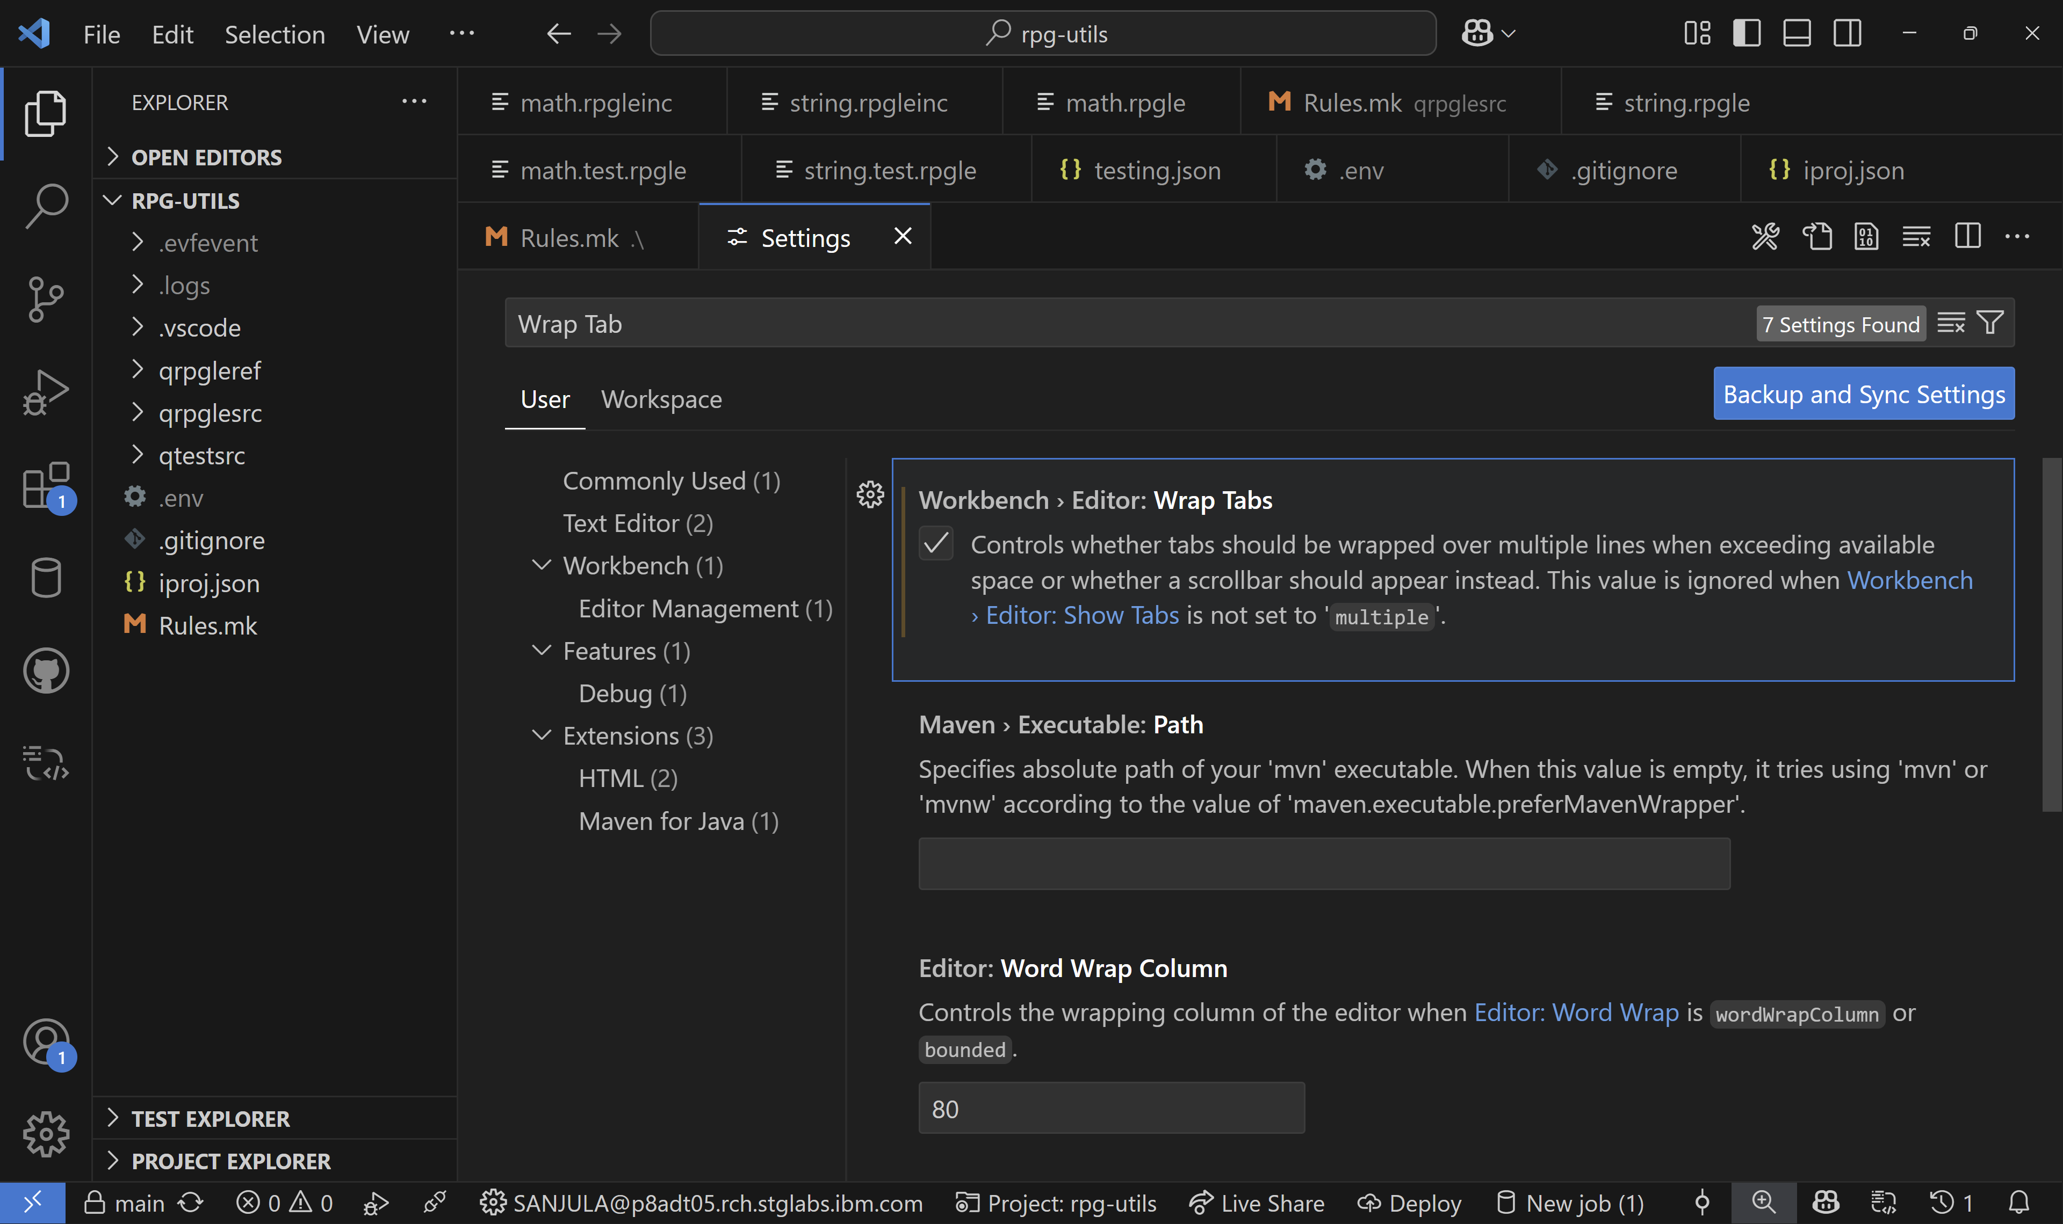
Code Navigation – Wrap Tabs
Enable the “Wrap Tabs” VS Code setting

Slide 7
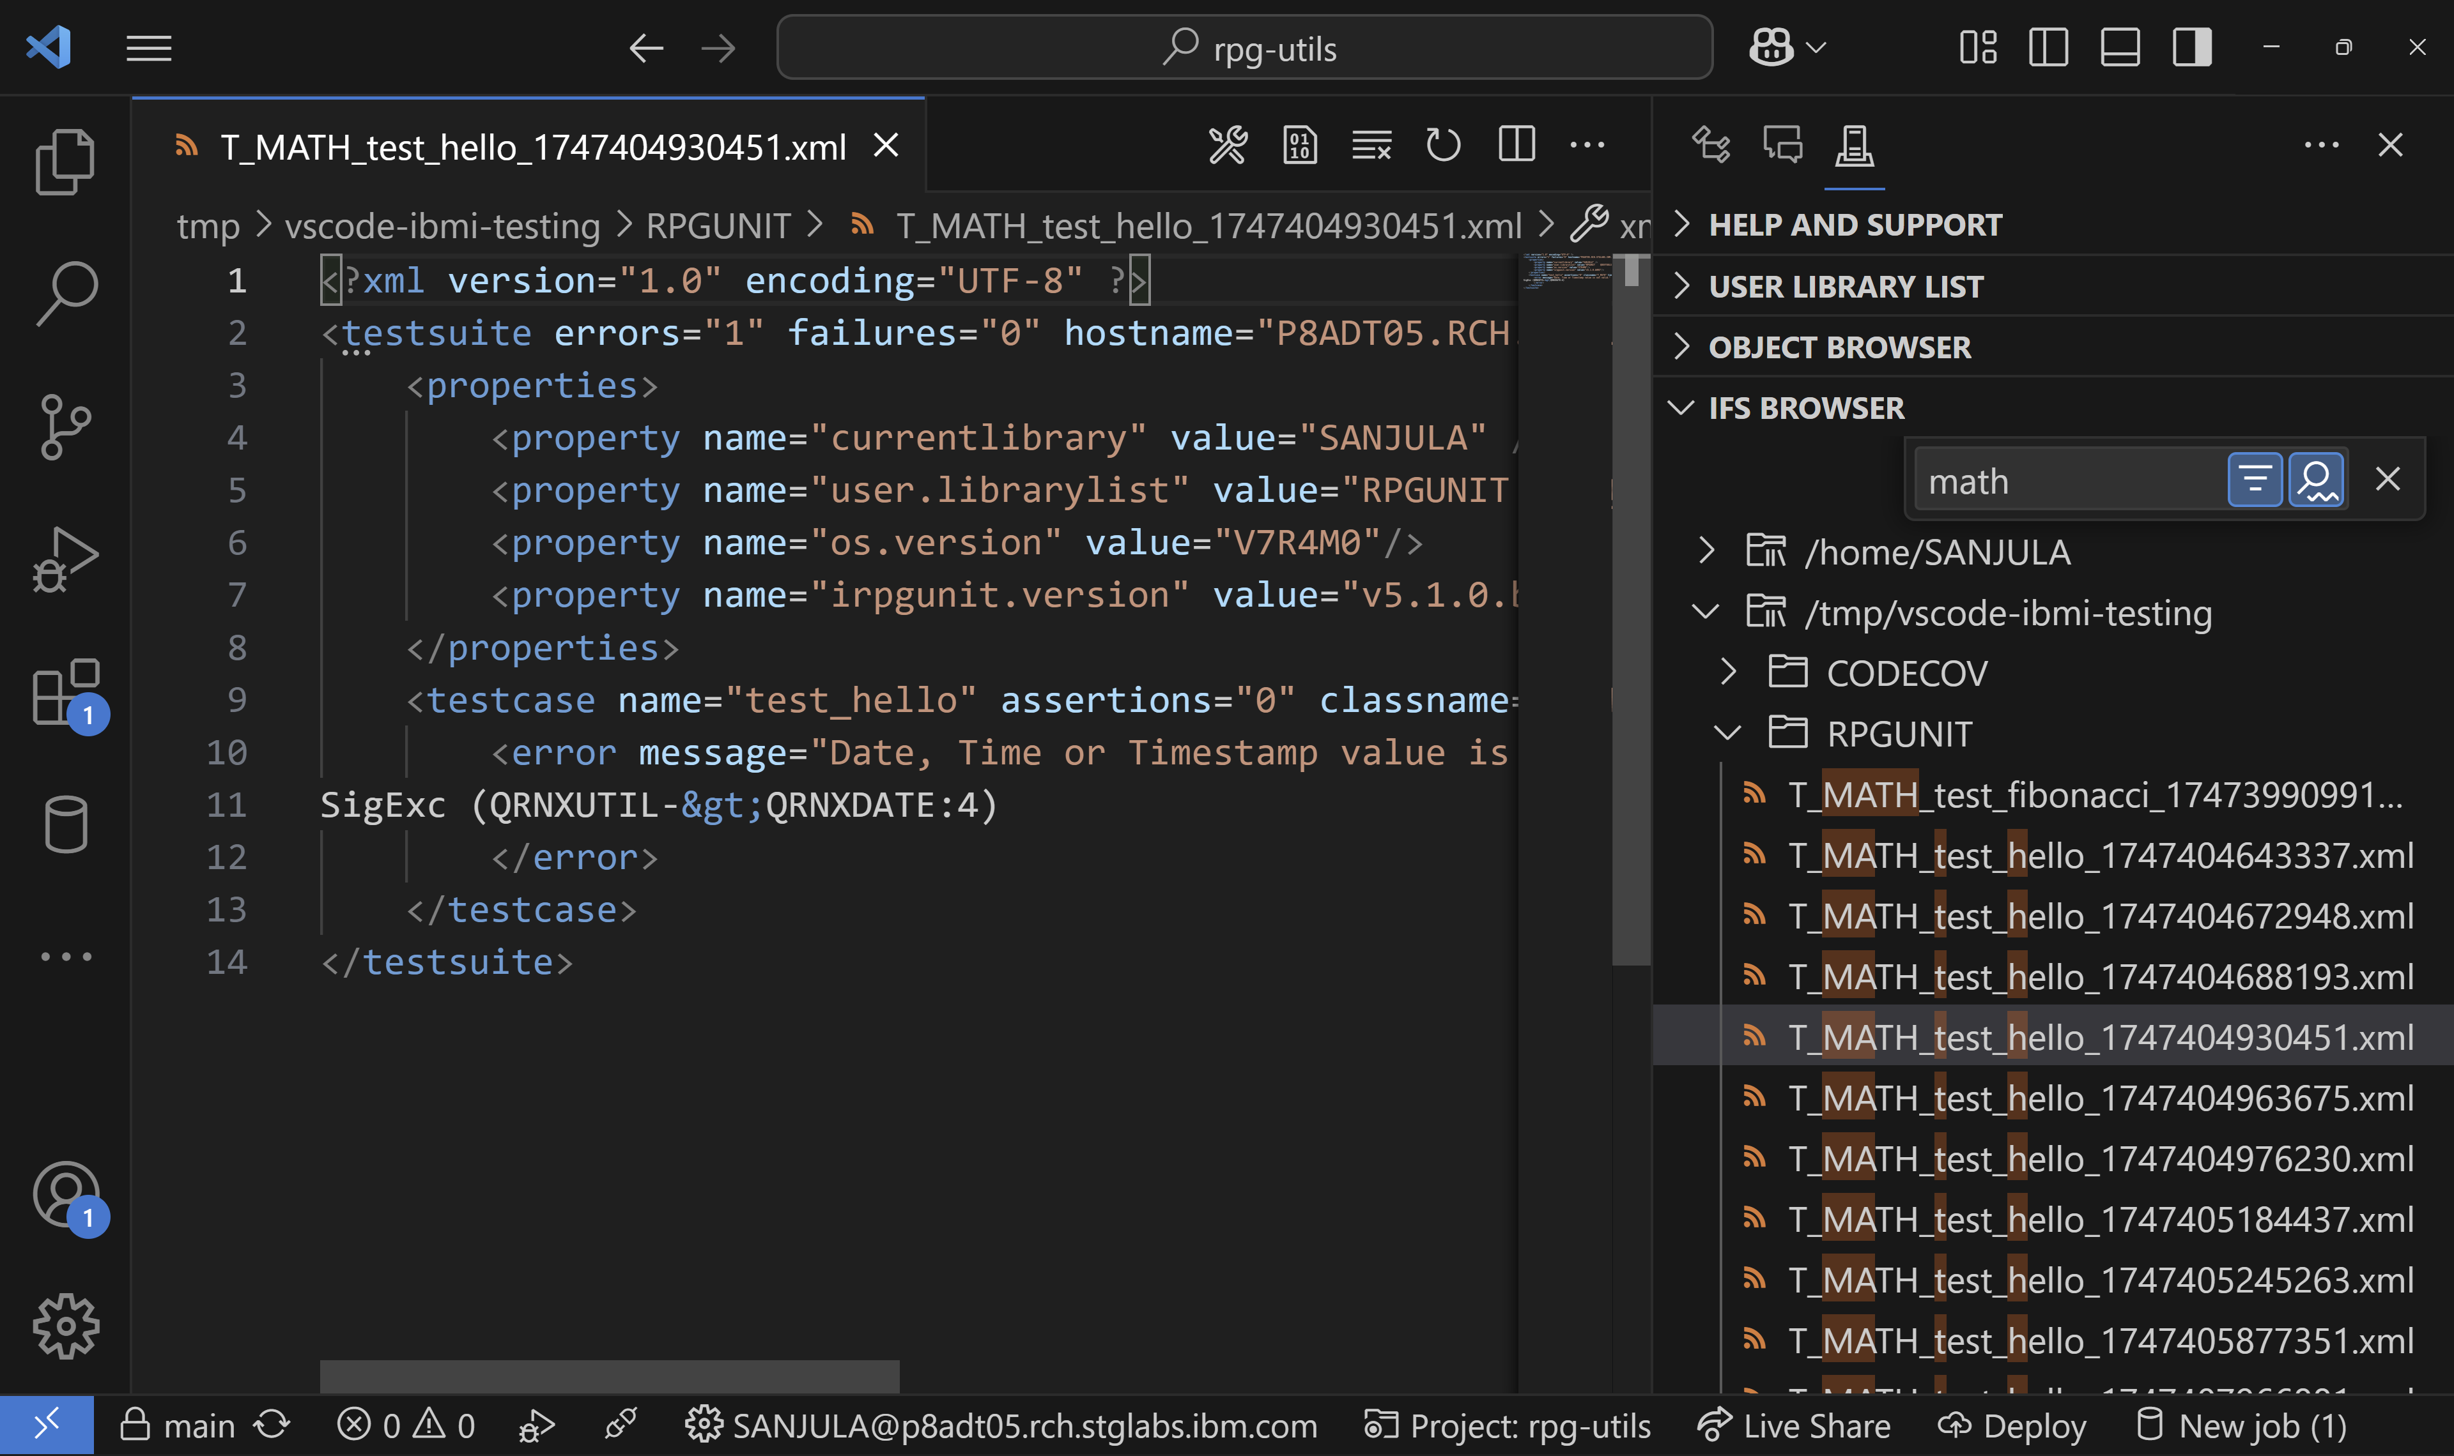
Code Navigation – Tree View Searching
Use “Ctrl + Alt + f” in any view in VS Code (including the Object/IFS Browser!)

Slide 8
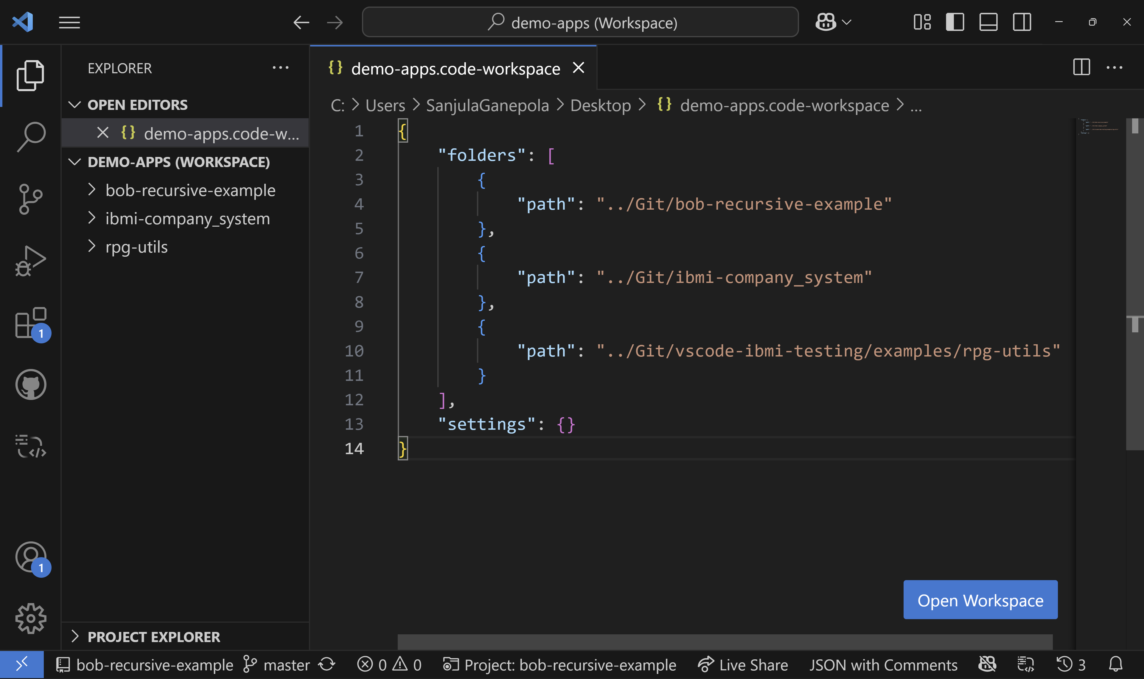
Code Navigation – Multi-root Workspaces
Use the command “Add Folder to Workspace” and “Save Workspace As”

Slide 9
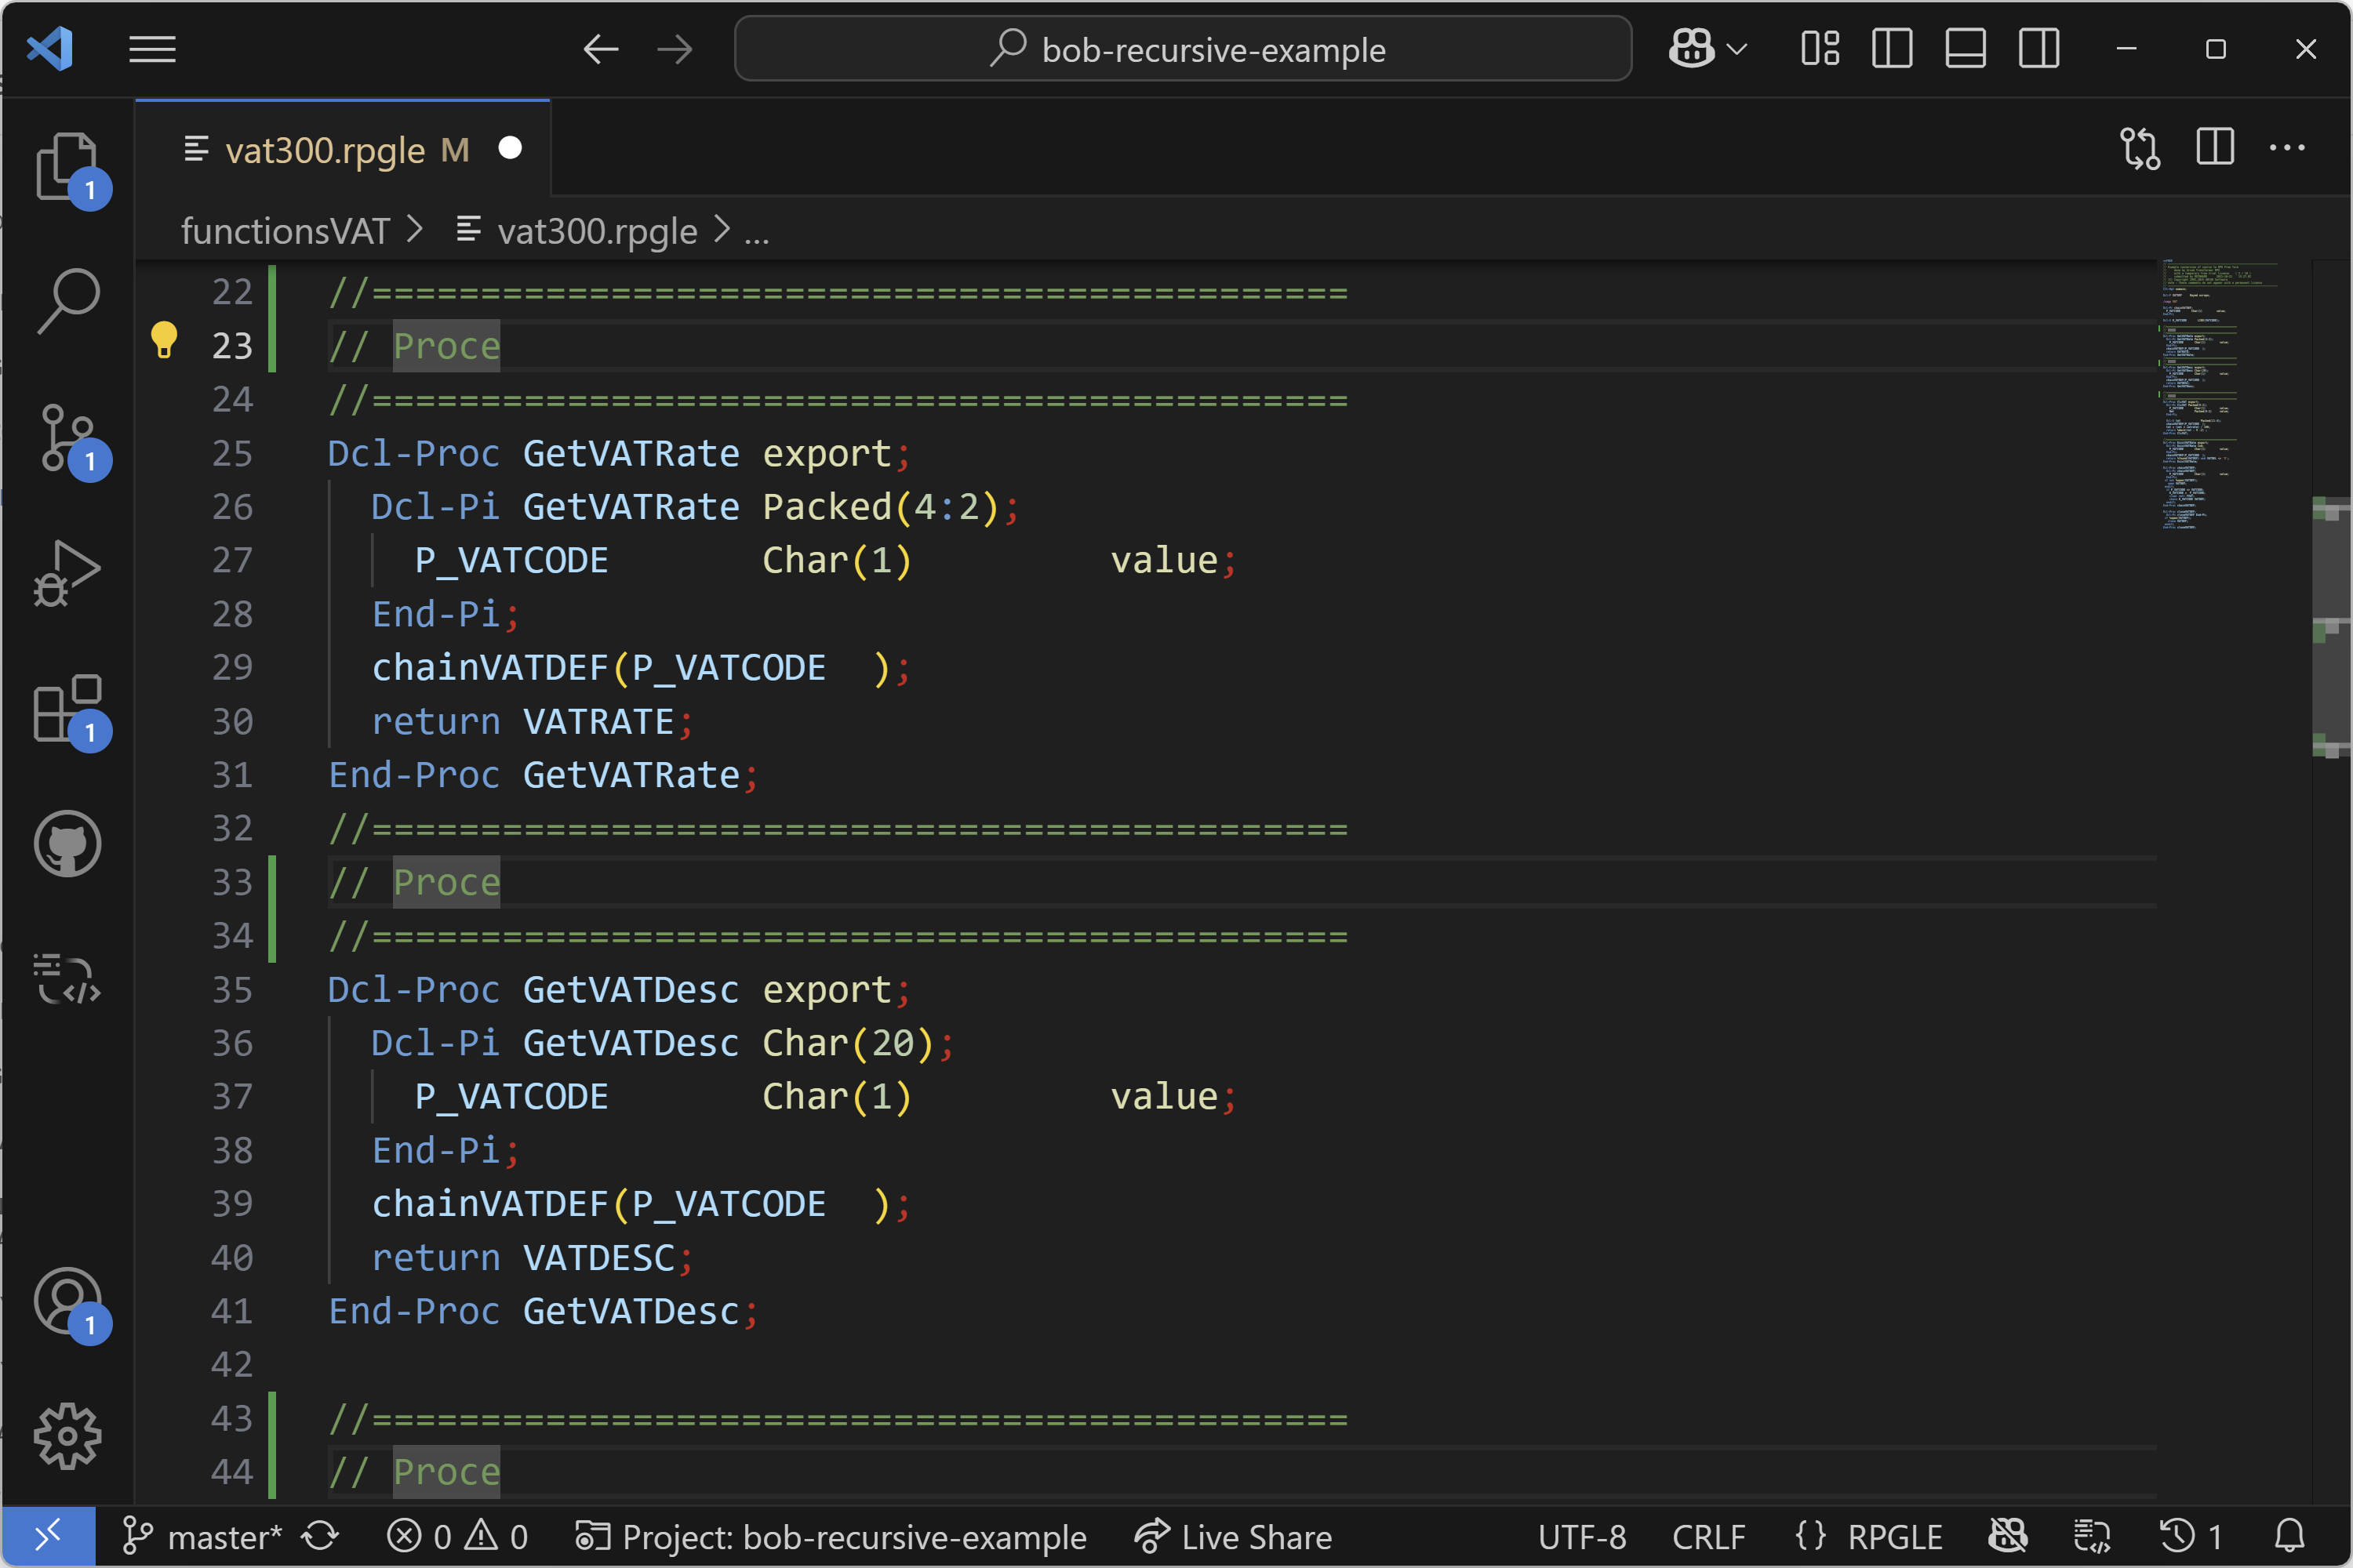
Code Editing – Multi-cursor
Manually add secondary cursors → Alt + Click
Keyboard shortcut → Ctrl + Alt + Down or Ctrl + Alt + Up

Slide 10
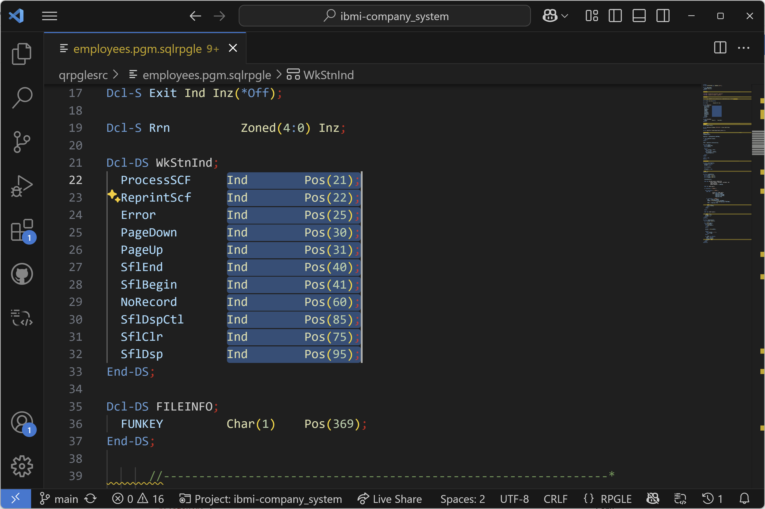
Code Editing – Column (box) selection
Shift + Alt while dragging

Slide 11
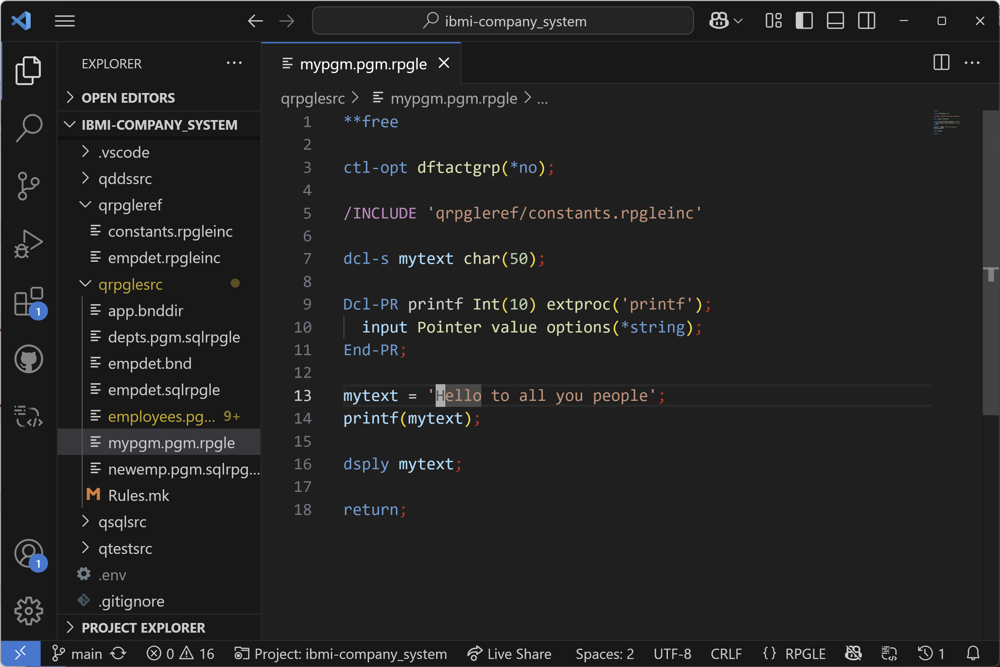
Code Editing – Overtype vs. Insert Mode
Use the command “Toggle Overtype/Insert Mode”

Slide 12
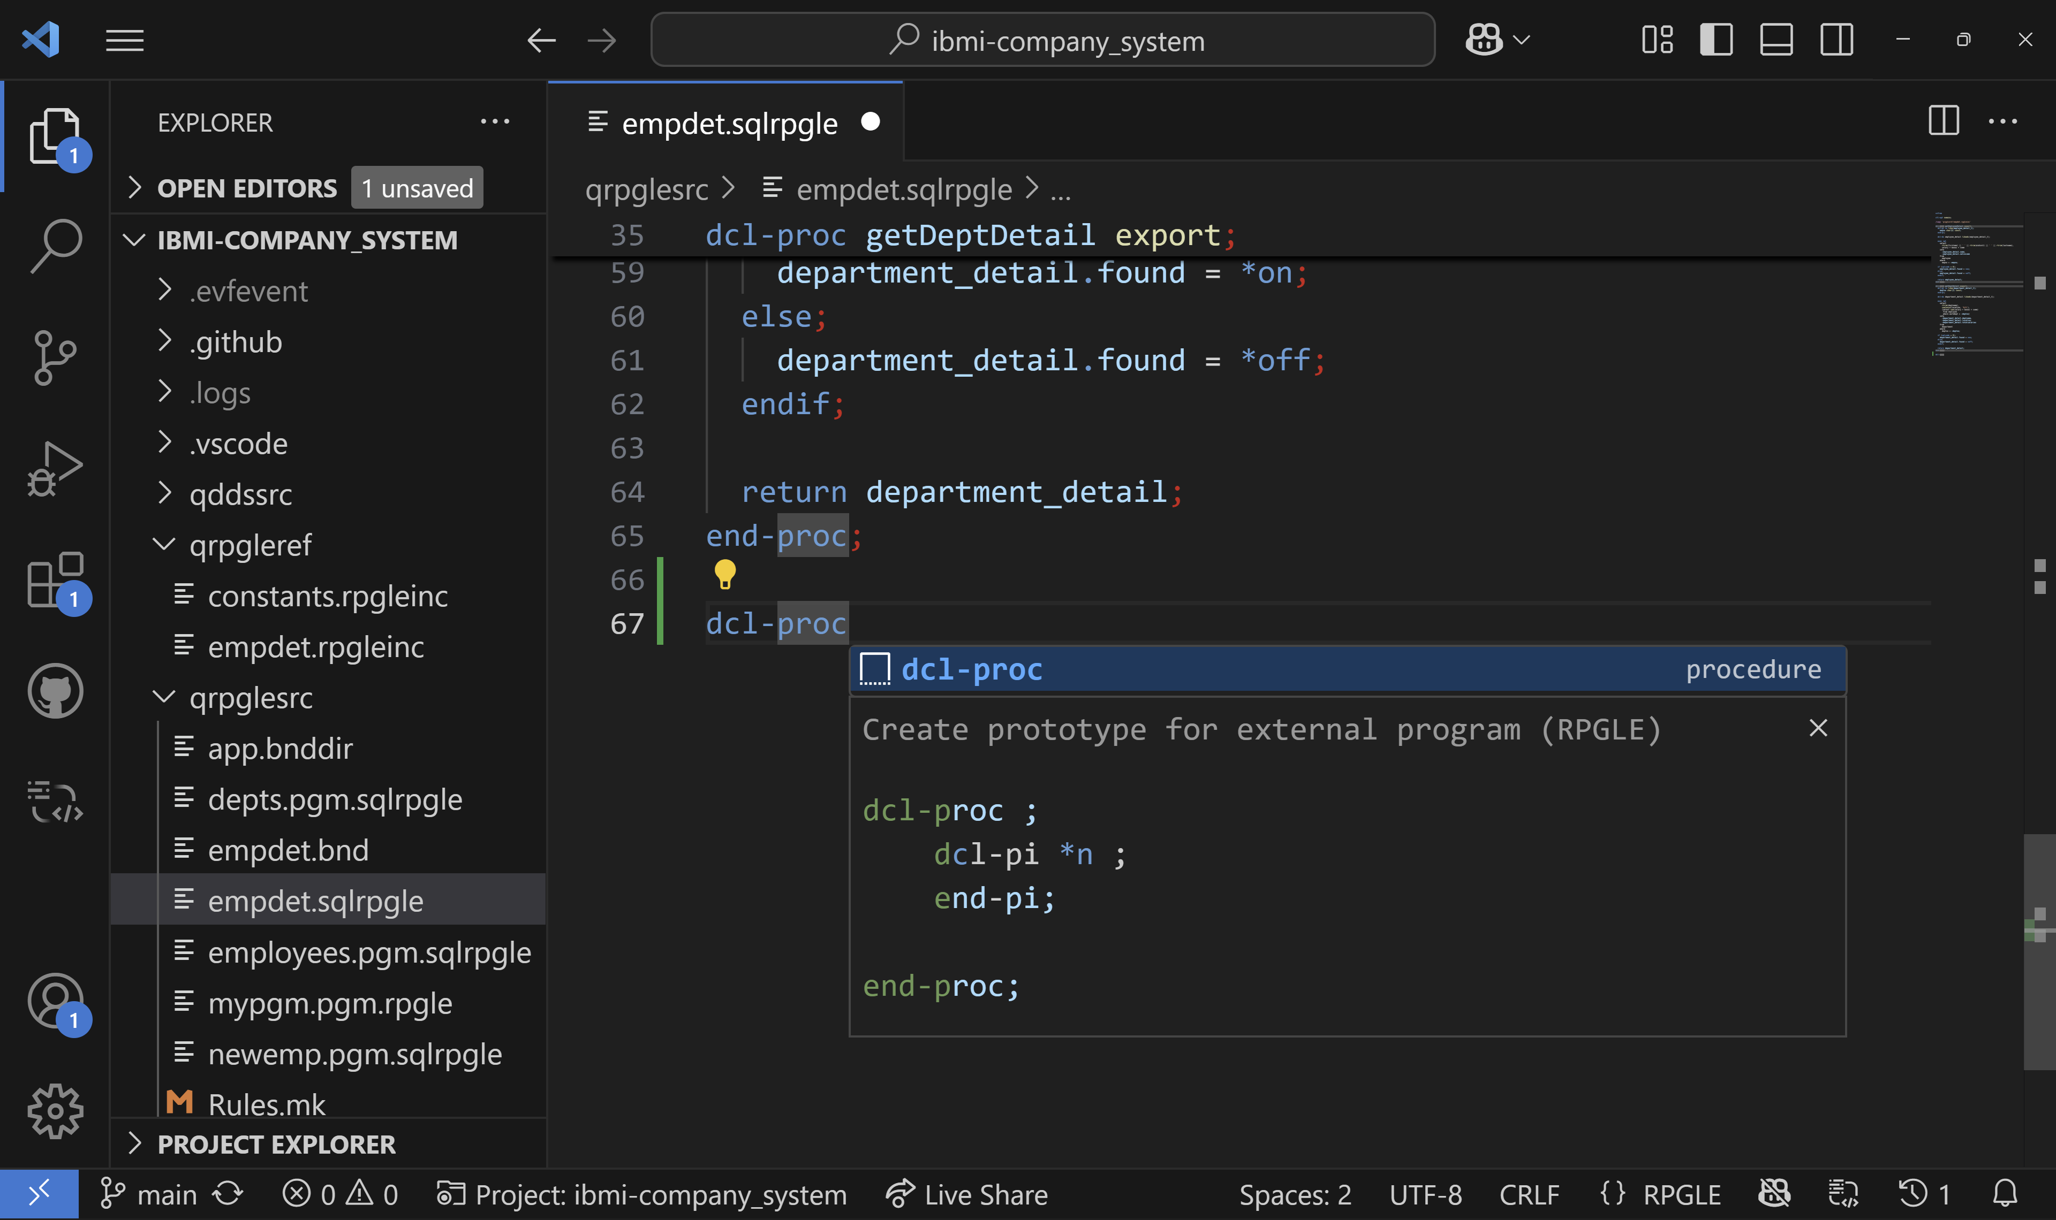
Code Editing – Code Snippets
Start typing the prefix for a snippet or use “Insert Snippet”

Slide 13
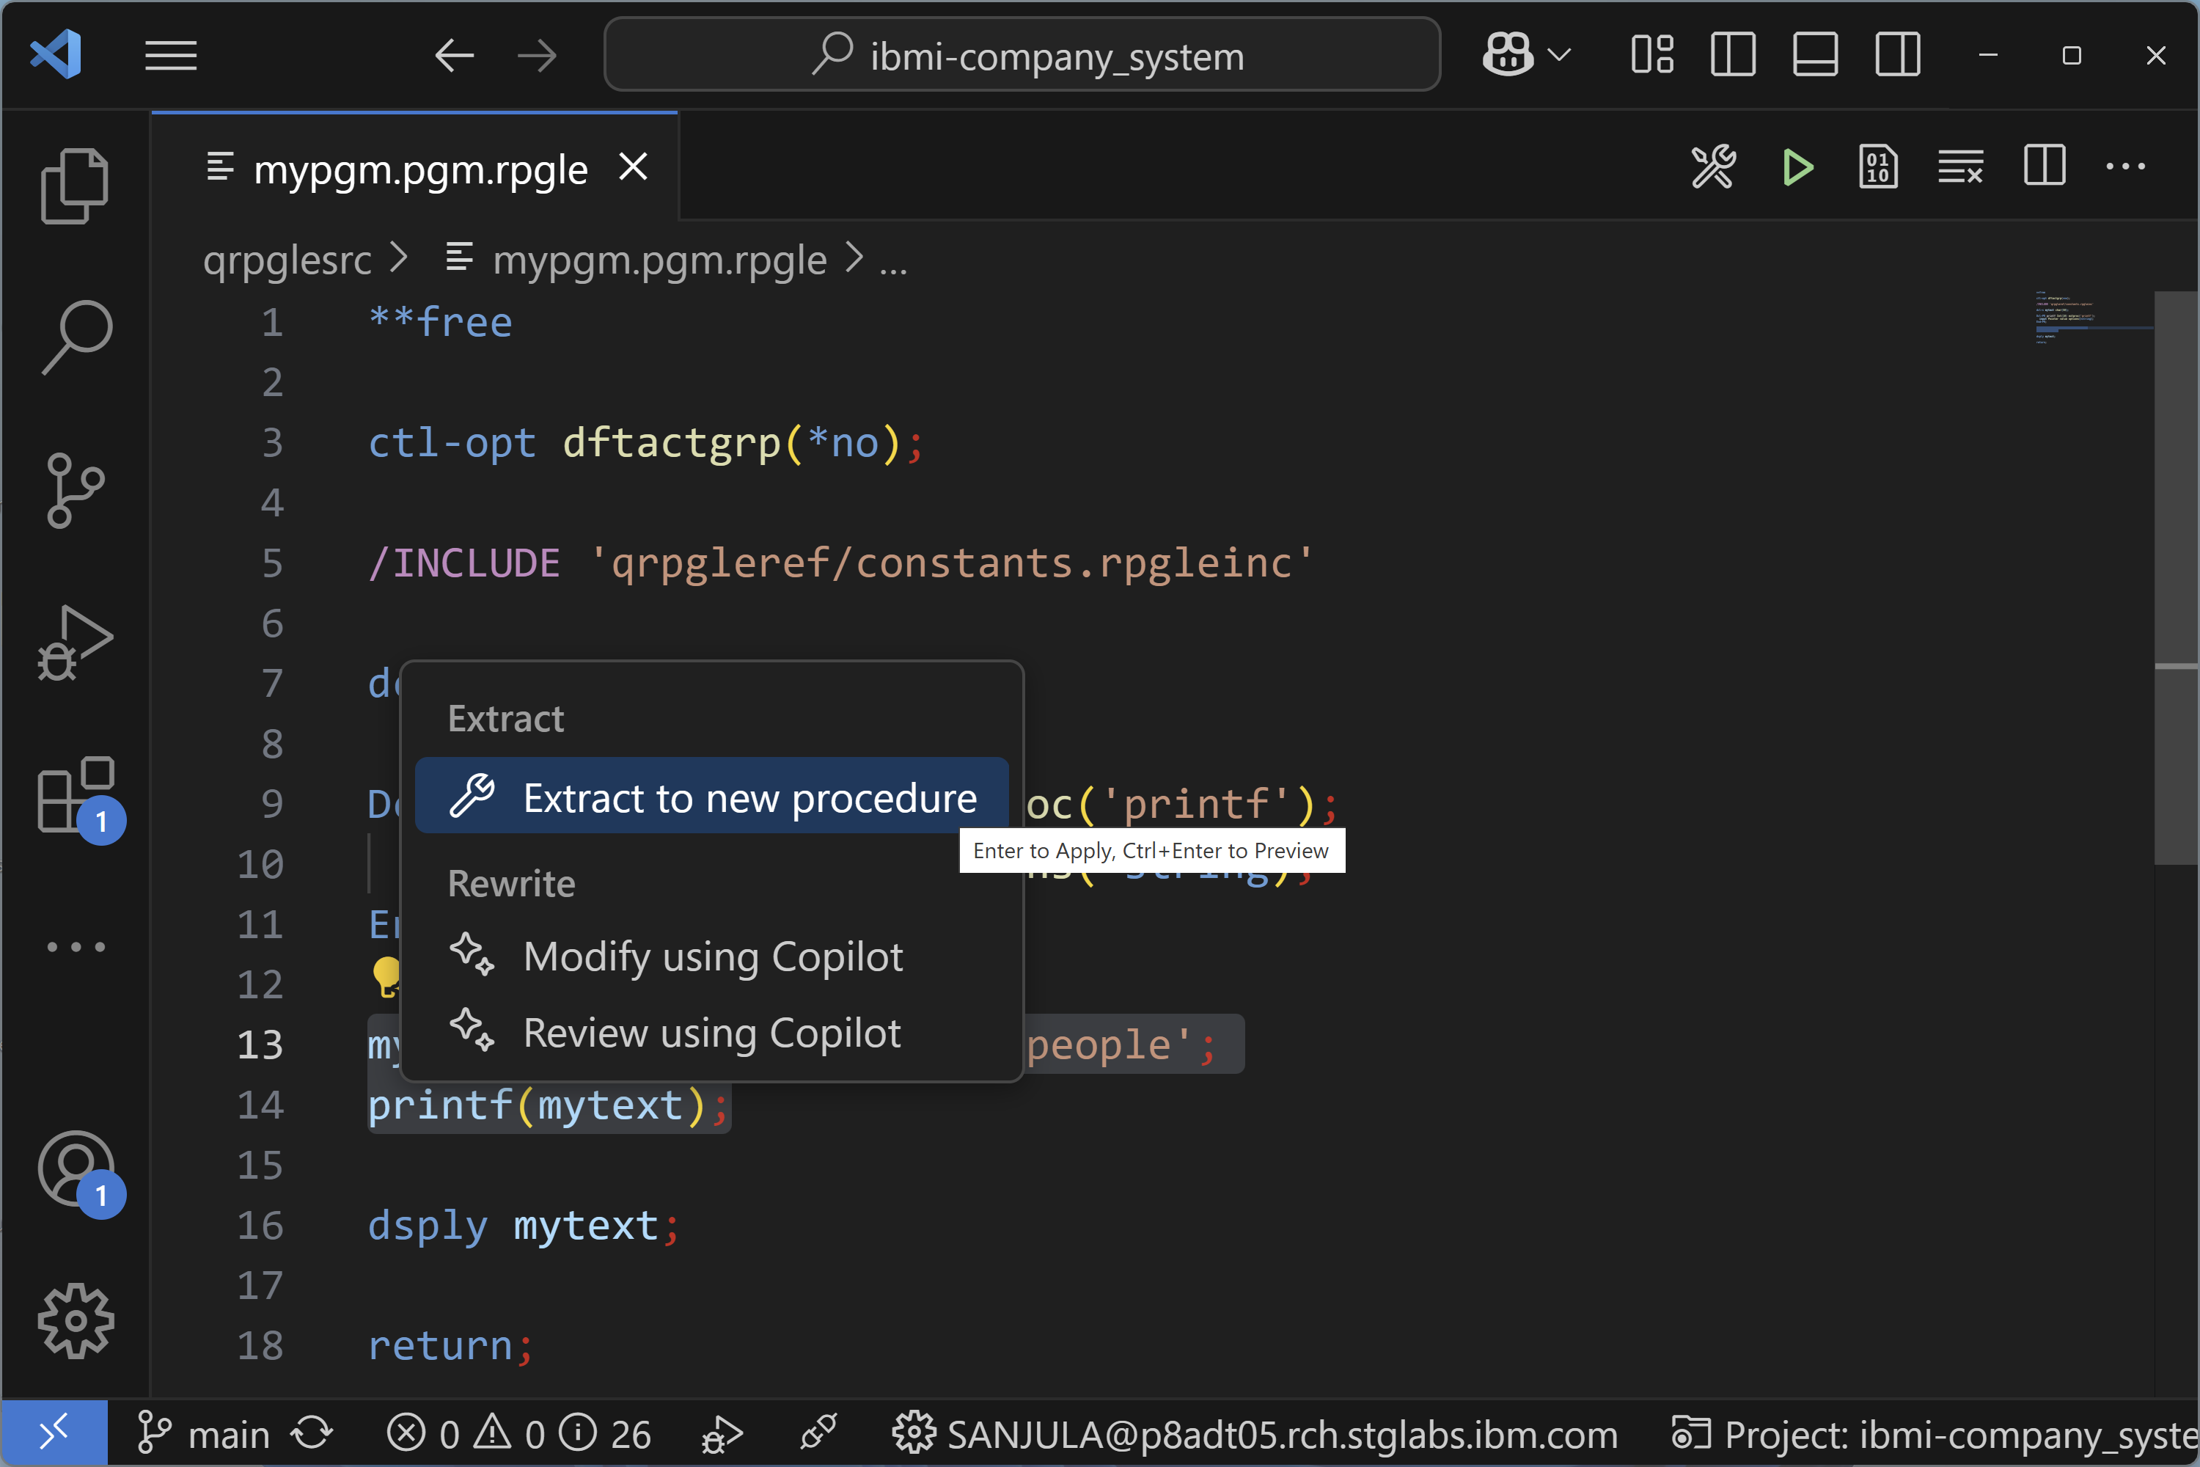
Code Editing – Code Actions (Extract to new procedure)
Extract code into a procedure

Slide 14
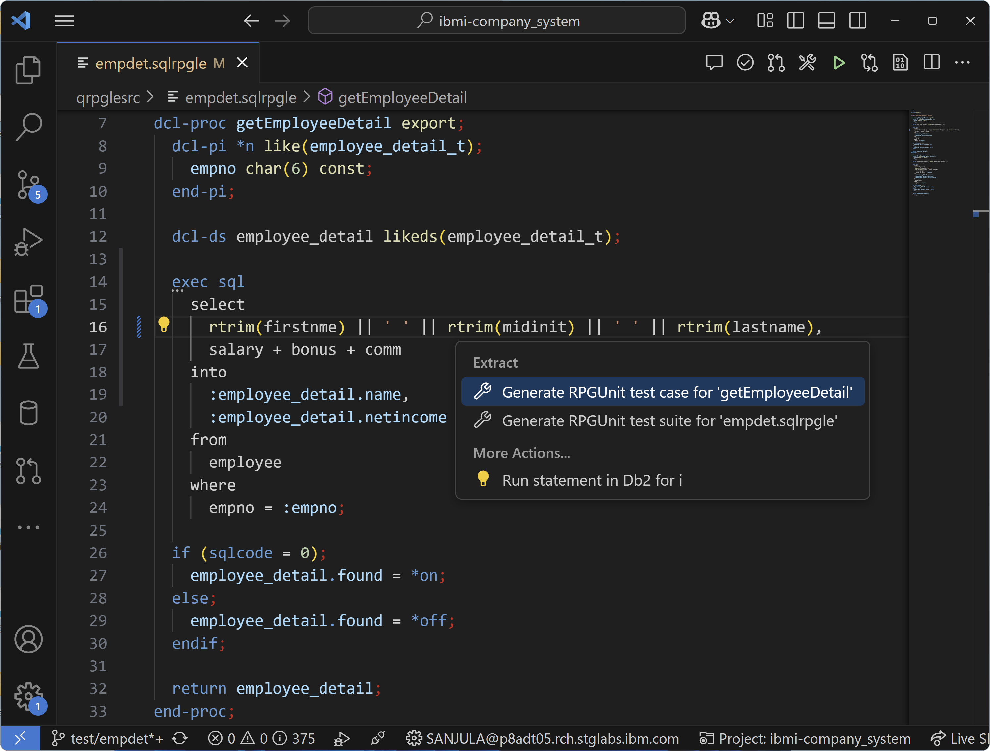
Code Editing – Code Actions (Test Stub Generation)
Generate RPGUnit test case or test suite

Slide 15
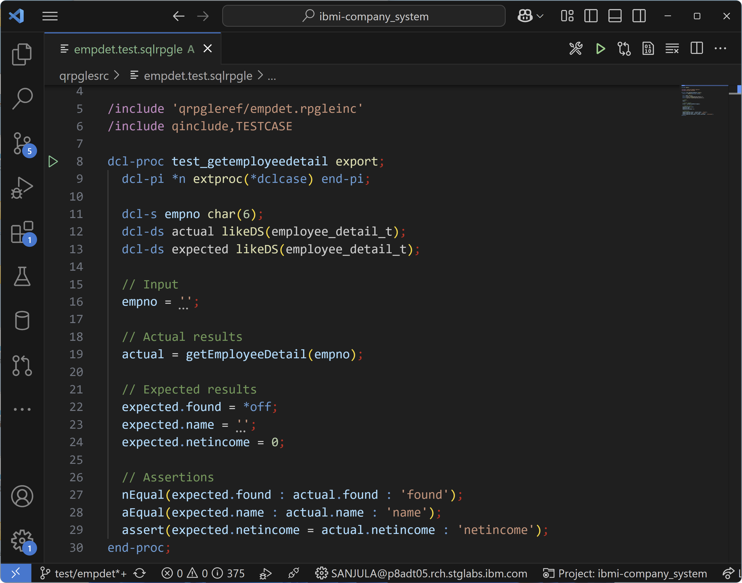
Code Editing – Fill in Test Stub
Fill in the test stub with inputs and expected results

Slide 16
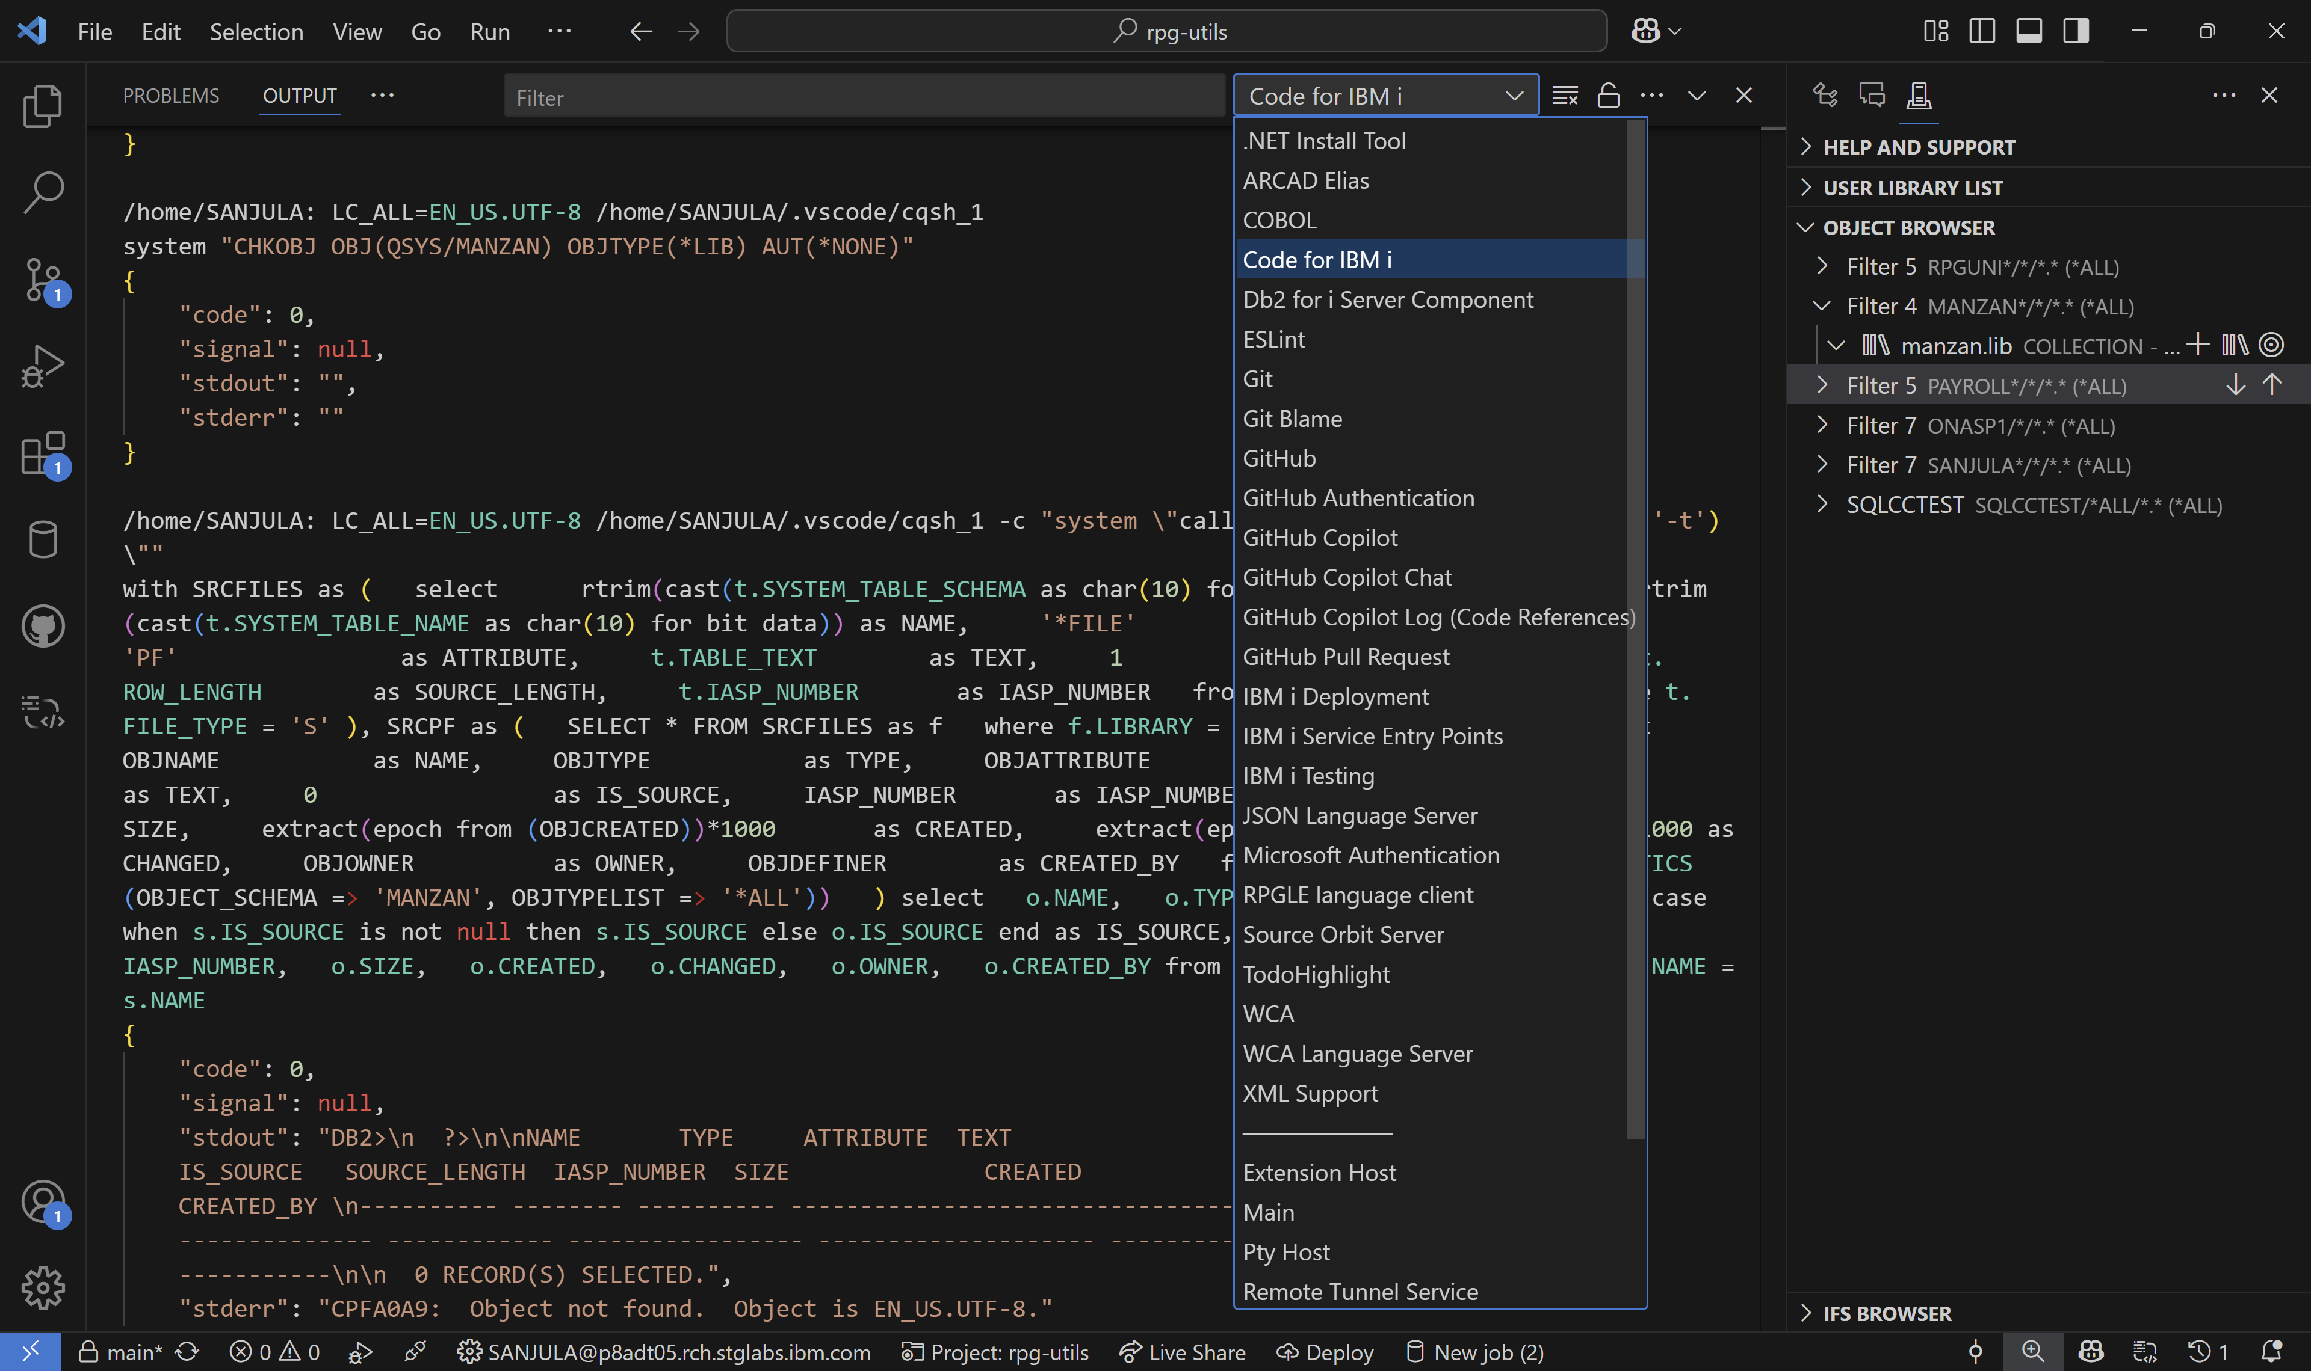
Extensions – Output Channels
Diagnose extension issues using the extension’s output channel

Slide 17
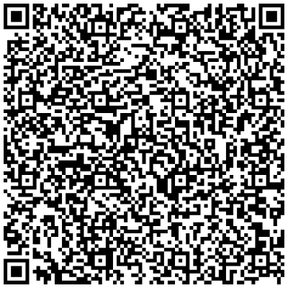
Sanjula Ganepola - VS Code Features You Didn’t Know Existed
Please take the last minute of this session to complete the evaluation. A direct link to the evaluation can be found using the QR code to the right.

